Slide 1
POWERSUPPLY
TEAM 16

Slide 2
POWER SUPPLY PROJECT
PURPOSE: power supply is used 1-to convert AC voltage to DC voltage 2- to convert high voltage to low voltage by using transformer in the beginning of circuit steps: **we will achieve our purpose by 4 steps : 1-Transformer:: our transformer used to convert 220 v to low voltage (35~36). 2- Rectifier:: this component used to convert two directional alternating-current (AC) to single directional direct current (DC). 3-Filter PROCESS :: this process occurs by using capacitor to smooth the wave but the repel is still here 4-Regulator:: this component used to move repel and produce constant DC voltage

Slide 3
Power supply project
1-Transformer:: our transformer used to convert 220 v to low voltage (35~36). -during bring this component we consider this important notes *the current which transformer need | ** the voltage which transformer need we must buy transformer with current 2 of current in circuit for safty factory and the voltage on this transformer is v (rms) not v peak where: vpeak=v(rms)*(2)^0.5.

Slide 4
Power supply project
2- Rectifier:: this component used to convert two directional alternating-current (AC) to single directional direct current (DC). Rectifier :: this component has 4 diodes.
NOTE: the high temperature will decrease the current in this compenet so we should use the heat sank but we solve that by

Slide 5
POWER SUPPLY PROJECT
3-Filter PROCESS :: :: this process occurs by using capacitor to smooth the wave but the repel is still here CONSIDERING THAT 1- THE CHARACTRISTIC IN CAPACITORS 2-CAPACITOR WARNING VOLTAGE V(W)=2V(RMS) 3-IN DATA SHEET WE CONSIDER THAT 1-IP OR I(FSM) ABSOLUTE MAX RATING 2-V(P-P) NOTE: CAPACENTANCE INCREASE →REPEL DECREASE→TIME DECREASE FOR STORING CAPACITOR→IP INCREEASE AND THIS WILL BRING SOME ISSUSES WHERE THAT IS GREATER THAN THE CAPACENTANCE IN DIODES

Slide 6
Power supply project
4-Regulater:: this component used to move repel and produce constant voltage there are 3 type
1-FIXED VOLTAGE POSITIVE 2-FIXED NEGATIVE VOLTAGE 3-ADJUSTABLE SET VOLTAGE NOTE: in this project we use the last one ADJUSTABLE SET VOLTAGE TO PRODUCE VARIABLE VOLTAGE WITH POTENTIOMETER CONSIDERING THAT 1-The minimum voltage which is the input (1.2~1.3). 2- the max current which is the output 1.5. 3- THE DATA SHEET FOR IC

Slide 7
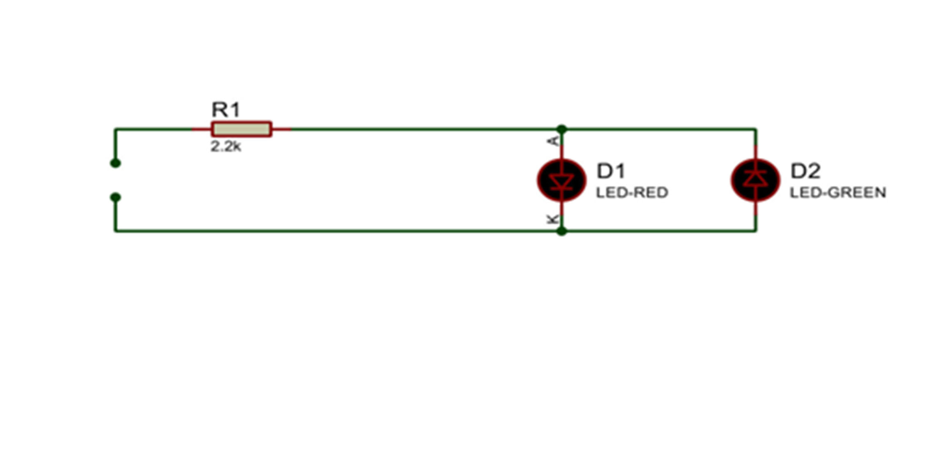
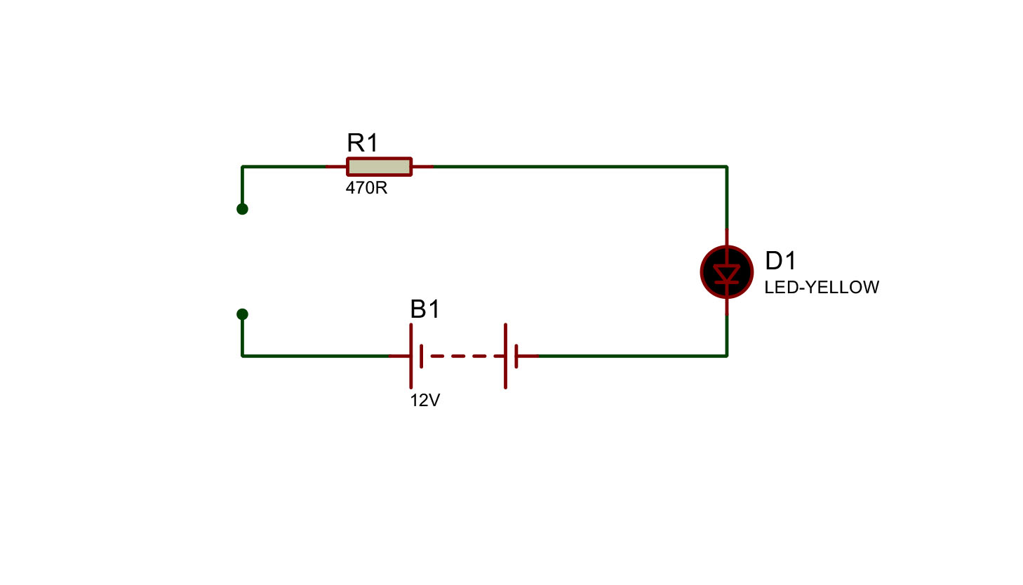
Power supply project
Recommedation: ** in regulator should be installed with heat sink to avoid any interruption in current and voltage output from the circuit . **we must take care power dissipation of resistor . 1-voltage polarity tester this circuit is used to test a dc voltage of unknown polarity 2-continuity tester this circuit is used for to check for continuity of cables connectors and switches

